Slide 1
IaC Support for On Premise and Managed Services
Lusaka Oct/Nov 2023
David Fry - INFITX

Slide 2
Overview of IaC
IaC has been built with a modular approach to support:
Different Kubernetes Distributions
Tested with k3s, microk8s and eks
Different Cloud Vendors Including Bare Metal
Tested with AWS and Bare Metal, wip Azure
Different Applications on top of Kubernetes
Tested with Mojaloop and PM4ML

Slide 3
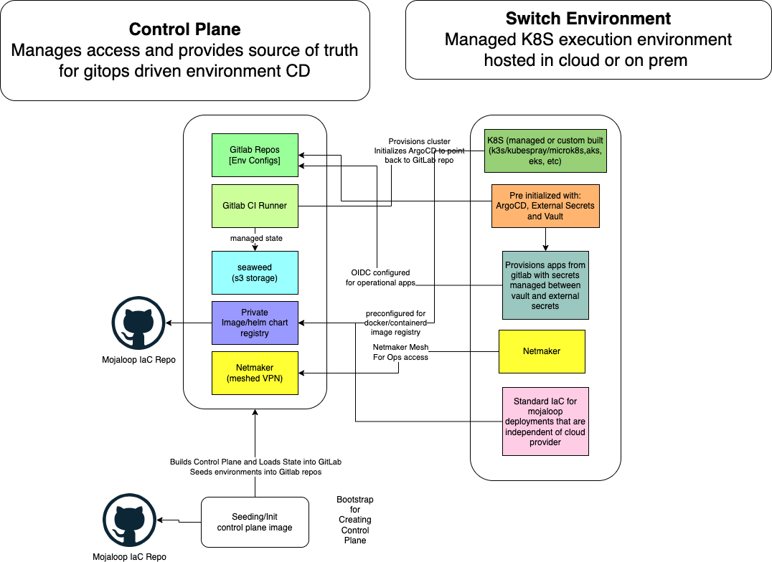
Base K8S Infra Module
Ansible K8S Deployment Module
GitOps Deployment Module
Configuration
Instance specific for Hub

Slide 4
The Modules of IaC
Base K8S Infra Module
Enables flexibility of deployment dependency configurations.
I.e. to support both lightweight developer deployments and full redundant resilient production deployments.
Ansible K8S Deployment Module
GitOps Deployment Module

Slide 5
Base K8S Infra Module
Base K8S Infra Module
Ansible K8S Deployment Module
GitOps Deployment Module
Cloud / On prem specific
Terraform Module Based
Creates either base VM/networking/security (on prem/DIY cloud) or essential components for managed k8s
Generates inventory file for ansible to be used in the next part of the pipeline (cluster provisioning)

Slide 6
Kubernetes Cluster Module
Base K8S Infra Module
Ansible module-based
Driven off of inventory file:
created in the base infra module but
is independent of the actual base infra module used.
Executes to create the Switch Environment:
Ansible K8S Deployment Module
GitOps Deployment Module
Step 1
Step 2
Step 3
Provision k8s cluster.
Options include kubespray, microk8s, k3s, eks, aks, etc
Installation of argocd, netmaker and external secrets into cluster.
Tools are configured to connect to Control Center Gitlab.
Seed root app for argo to pull app details from Control Center Gitlab.
After this module, no access to the cluster needed from Gitlab, all pipelines are done via gitops pull from the cluster controller (argocd)

Slide 7
GitOps Module - Runs on any K8S Cluster
Base K8S Infra Module
Terragrunt(Terraform) Module that
Constructs the configuration files that are
used to drive gitops-based deployment of apps.
Creates foundational apps along with appropriate secrets created via external-secrets Gitlab and Vault Cluster Secret Stores.
external-dns
certificate-manager
longhorn storage (can be replaced with ceph/etc)
vault and vault-config-operator
stateful-resources
Istio for service mesh and ingress and egress gateways
mojaloop / payment manager
→ Output is a gitlab repo with appropriate config files (no secrets)
The argocd operator in the Switch Environment pulls the deployment artefacts from this repo to establish the working environment.
Ansible K8S Deployment Module
GitOps Deployment Module

Slide 8
End State - Working Switch Enviroment
GitOps managed deployment providing:
Base components for security,
Ingress control, and
Monitoring needed by any application.
Modularization deployment of mojaloop or Payment Manager
Security baseline provided via Connection Manager, Keycloak and Istio includes:
IP whitelisting,
JWT and JWS Validation
mTLS
WIP - using Ory Stack to provide consistent authorization across the APIs and Web Applications.

Slide 9
IaC PI-23 Highlights (for the record)
Added microk8s as a 2nd K8s option (as well as K3s)
Added EKS as a 3rd K8s option
Added Istio (K8s native option as ingress gateway)
Added Keycloak option as identity provider and JWT issuer
Using Istio + Keycloak to control API access i.e, NO WSO2!!!
Added K6s instance as option for cluster deployments to facilitate the load testing effort (+perf characterisation workstream)
Added support for PM4ML deployments using same IaC components as Mojaloop deployments.
Finalizing modules for bare metal deployments.
Built out modules for running Managed Database services as drop in configuration replacement for in-cluster databases. Tested with RDS
Added argocd post-sync GP test execution via ttk jobs
Connection Manager integrated with keycloak and istio as well as new vault

Slide 10
Current Work and Next Steps
Working with community members to build out managed Kubernetes modules for AKS and OCI.
End-to-End testing through Payment Manager
Support for K6S module to leverage performance testing initiative.
Finish the managed Kafka implementation on AWS and build out managed services on different cloud providers
Complete the testing of the bare metal module
Functional testing
Performance Baseline
Request for contribution for security assessment

Slide 11
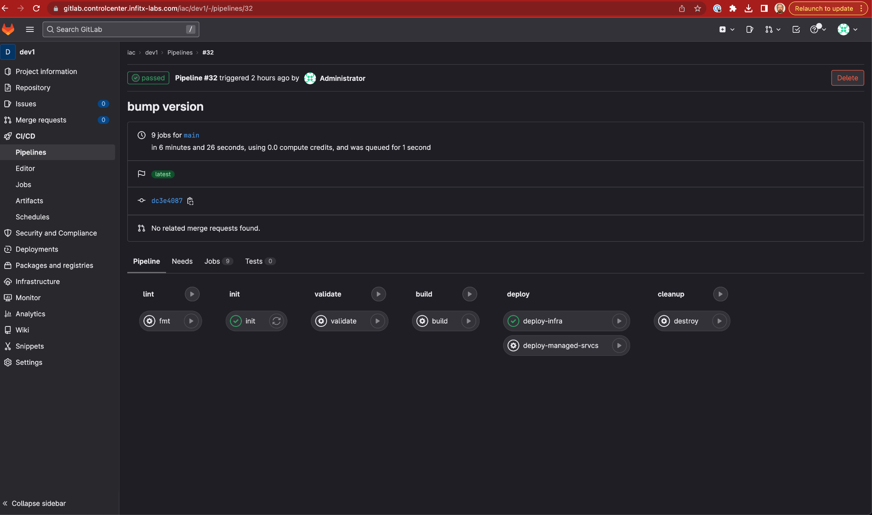
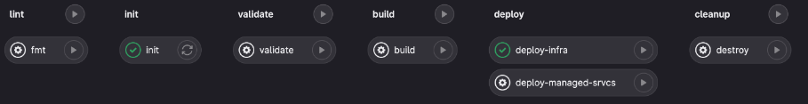

Slide 12
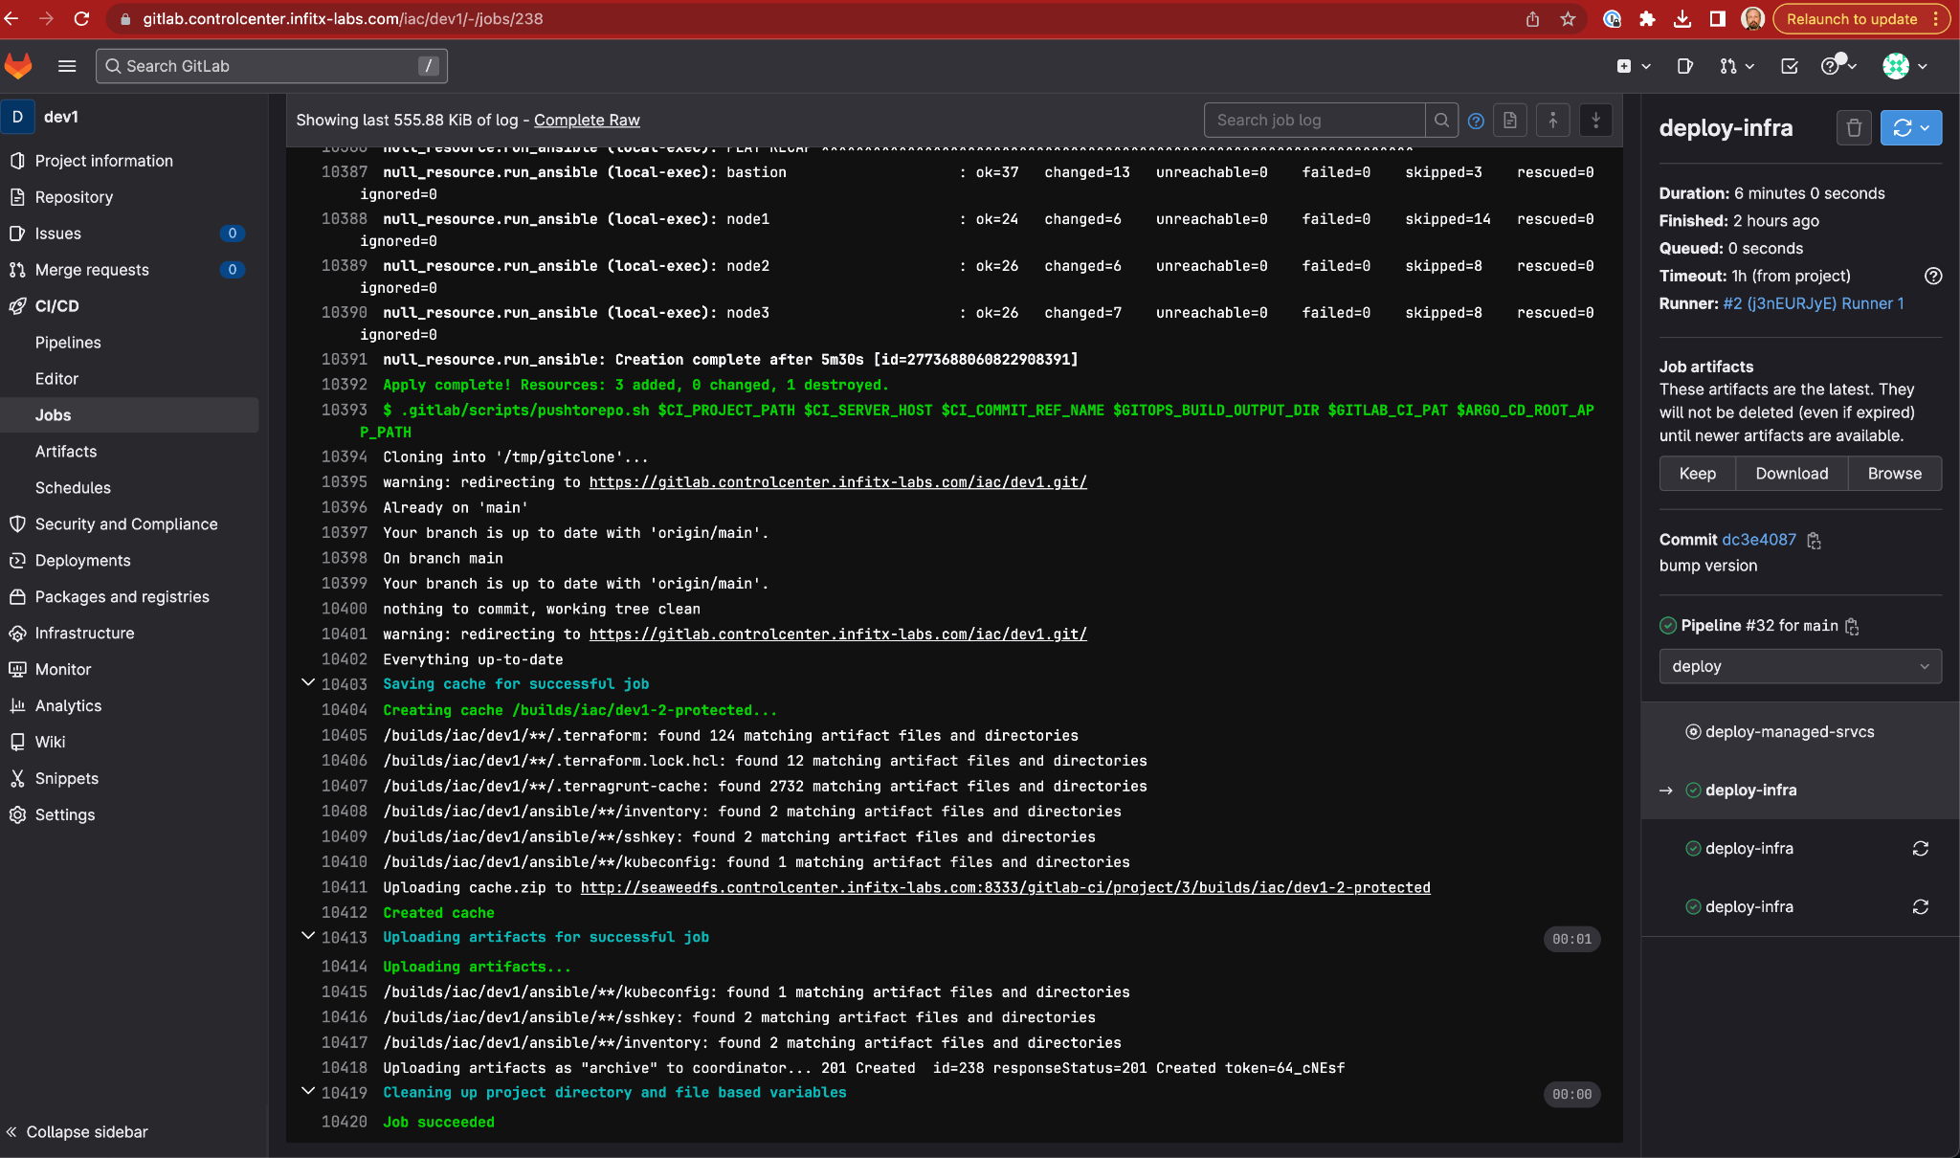

Slide 13
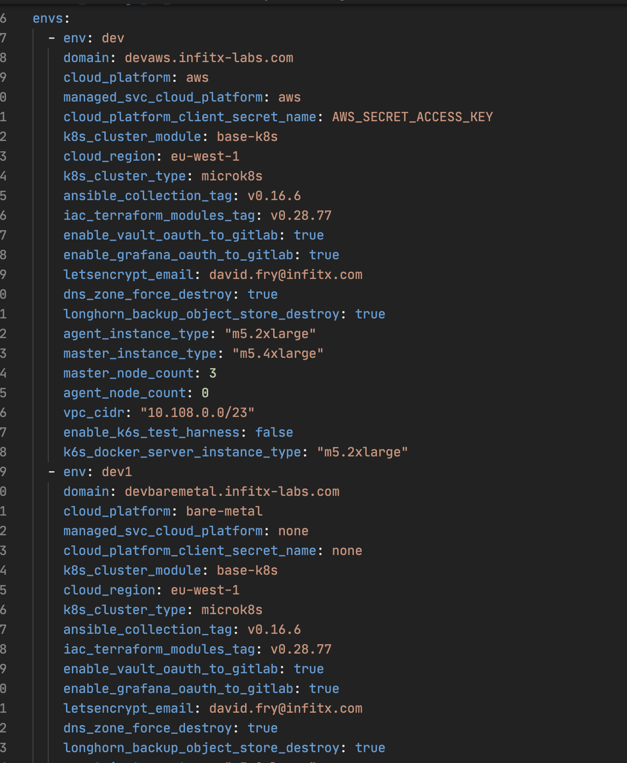
AWS environment configuration
Bare-Metal environment configuration

Slide 14
Reach out to participate
Email: david.fry@infitx.com
Mojaloop Slack: @David Fry
https://github.com/mojaloop/iac-modules
https://github.com/mojaloop/iac-ansible-collection-roles

